Slide 1
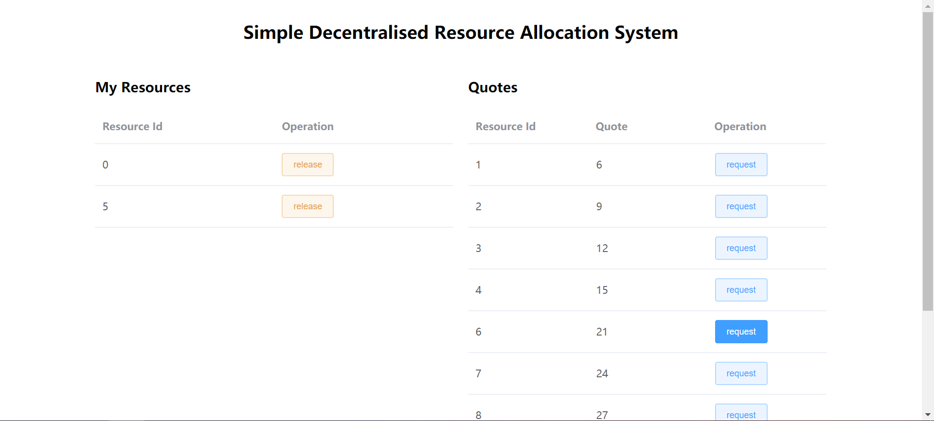
A Simple Decentralised Resource Allocation
7CCSMDLC Group Project - by BlockDance Team

Slide 2
Demo

Slide 3
Decentralised Solution
Administrators should obtain relative statistics
Administrator launch an allocation event: create accounts, set quotes, deploy contracts
Administrator send specific accounts to every user
Users begin to claim their demands to interested modules, by submitting resource applications.
When it hits the deadline, administrators manually trigger the contract to perform initial allocation.
Users could request for still available resources in the system, or release the resources that are not wanted any more.

Slide 4
A resource allocation model
Stage 1: users claim their demands, and then at the end of this stage, users could get the resources they needed if there are enough resource, or otherwise resources would be randomly allocated to users demanded.
Stage 2: users could release the resources they don't want any more, and compete for spare resources.

